Slide 1


Differentiated Instruction and Choice Activities through Creativity, Critical Thinking, Communication, Collaboration
Stefanie L. McKoy
Krystle E. Merry
University of Arkansas – Fayetteville

Slide 2


Stefanie L. McKoy
Krystle E. Merry
Elementary Education B.S.; Missouri State University ​​
Early Childhood Education Certified- B-3 Missouri, PK-4 Arkansas Teacher Licensure​​;
Elementary Education Certified – K-6 Missouri, 1-6 Arkansas Teacher Licensure​​;
Gifted Education Certified K-12 - Missouri, Arkansas Teacher Licensure​​
Educational Technology Leadership M.Ed.; University of Arkansas​​
Currently working on Ph.D. in Curriculum and Instruction with Gifted focus; University of Arkansas​​
Research in gifted education, teacher preparedness, and digital ethnography​
Middle-Level Education B.S. Ed.; University of Arkansas
Gifted and Talented Education, M.S. Ed.; Arkansas State University​​
National Board-Certified Teacher – Exceptional Needs Specialist​​
Special Education K-12 Endorsement, Texas Teacher Licensure​​
English to Speakers of Other Languages (ESOL) Endorsement; Henderson State University​​
Currently working on Ph.D. in Special Education Curriculum and Instruction, University of Arkansas​​
Research in special education transition, twice-exceptional, and assistive and educational technology​

Slide 3
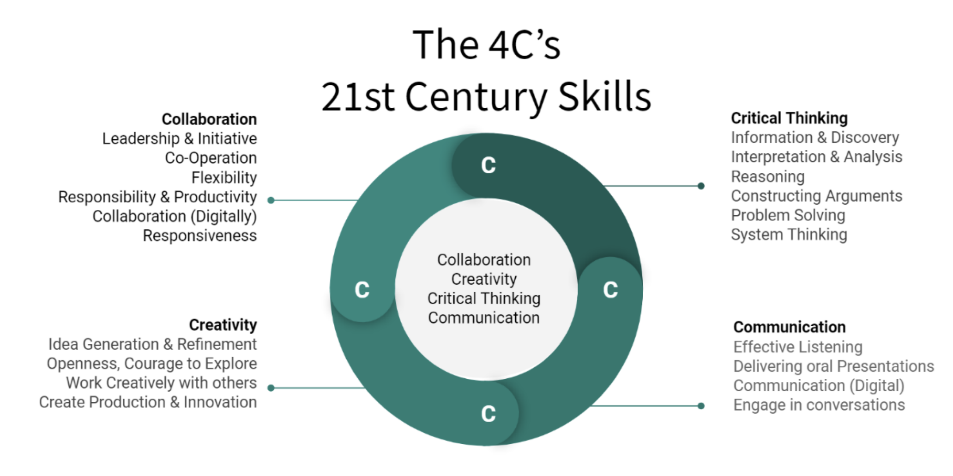
Mazzola, Colette. (2020). To what extent does education prepare students for the 21st century to become self-regulated, future-proofed students, using networked, technological environments.. 10.13140/RG.2.2.18400.10246.

Slide 4
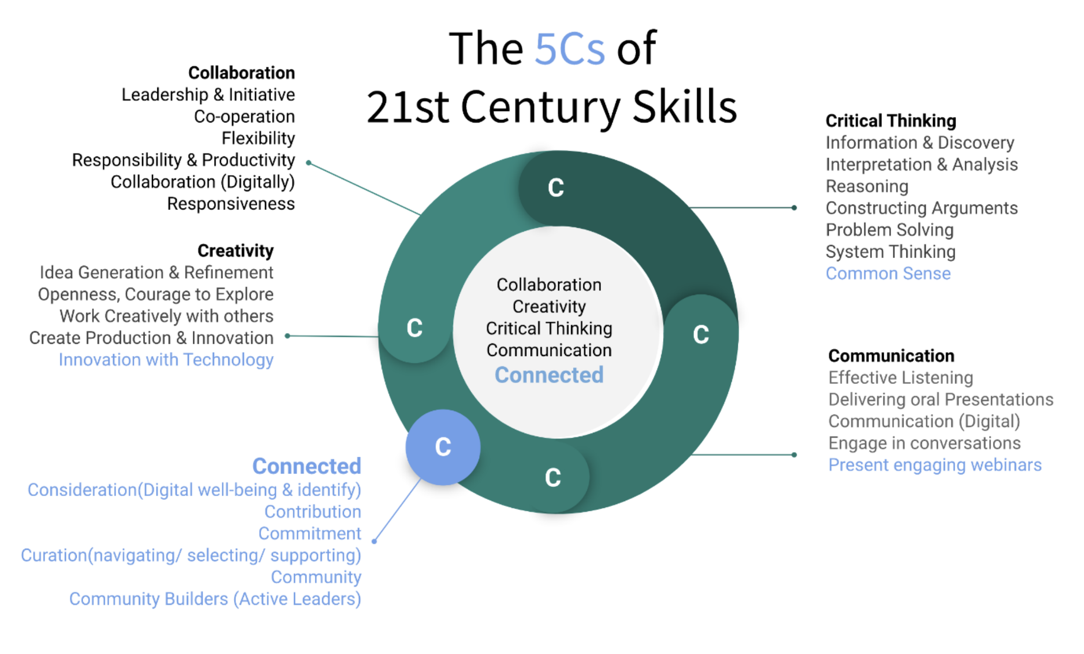
Mazzola, Colette. (2020). To what extent does education prepare students for the 21st century to become self-regulated, future-proofed students, using networked, technological environments.. 10.13140/RG.2.2.18400.10246.

Slide 5
Each brain is uniquely organized.
The brain is a lean pattern- making machine.
The brain’s frontal lobe is often referred to as the executive center because it directs much of the brain’s activity.
Emotions are processed in the brain’s limbic system and play an important role in pattern making.
Learning is as much a social process as a cogitative one.
We are learning a lot more about our memory systems
Learning for retention requires focus and extended attention.
Brain Research and Differentiation
(Tomlinson, 2014, p. 15-17)

Slide 6
The Learning Environment Actively Supports Learners and Learning
The Teacher Actively Attends to Student Differences
The Curriculum is Organized to Support Learning
Assessment and Instruction are Inseparable
The Teacher Modifies Content, Process and Products Based on Student Readiness, Interest, and Learning Profiles
The Underpinnings of Differentiation
(Tomlinson, 2014, p. 15-17)

Slide 7
Creativity
Critical Thinking
Differentiation and Choice
Interest – Arts Integration
This week we discuss student interest and profiles. We will pay particular attention to arts integration. For this week's journal, you are going to go on a virtual scavenger hunt! Download the PowerPoint file or copy the Google slide presentation to edit. Follow the directions to scavenge the interest (or your home) to create your own file. I have shared my example for an American Revolution unit. Share your file with me. If you need help, please reach out!
Tips:
  Use the Insert feature to add YouTube videos, audio, or other videos to your presentation.
  The slide is set with a background so the only items to be modified are the textboxes. This is a great way to offer the same type of activity for students without them altering all the 'pretties' in a slide.
  I used Canva for the template. There are many free templates. I do pay for the premium monthly subscription because I use it so frequently.

Slide 8

Name:
Unit:
TITLE
TITLE
TITLE
TITLE
TITLE

Slide 9
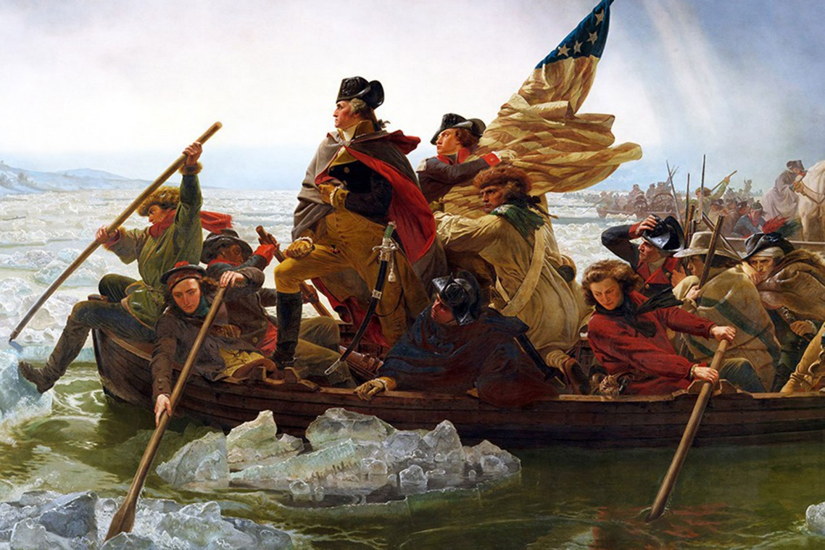
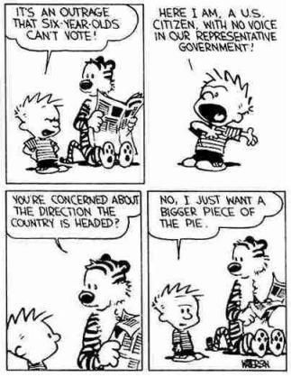



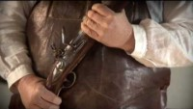


Name: Stefanie McKoy
Unit: American Revolution
Painting
Comic
Digital Art: Photograph of Loyalists
Piece of Music
“Too Late to Apologize: A Declaration” Video Song
Yankee Doodle

Slide 10
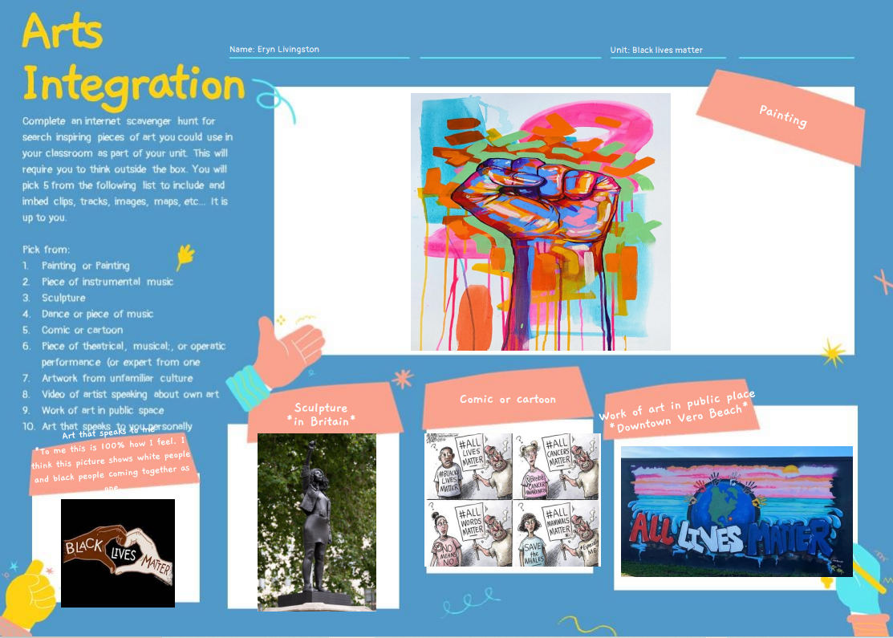

Slide 11
Creativity
Critical Thinking
Differentiation and Choice
Product: RAFT
Think about the reading and videos about managing a differentiated classroom. The book specifically discusses classroom environment, the principles in leading students, helping students become leaders, and day to day management of the classroom. For this week's journal, you will get to use your creative brain.
Here is a YouTube video explaining the Raft : https://youtu.be/oaWp4twgltE (I think it is a student project.)
(Doubet & Hocket, 2015, p.232; Doubet & Hocket, 2017, p. 285 )

Slide 12
(R) Role | (A) Audience | (F) Format | (T) Topic
Special Education Teacher | Regular Classroom Education Teacher | Photographs and descriptions | What are some learning and behavior gains from differentiated learning?
Principal | Community | Video presentation | How might a differentiated classroom sound or look like?
Parent | School Board | Speech | What routines and procedures are helpful when starting to develop differentiation in the classroom?
Community Member | Administration | Letters | How is managing and leading different in a differentiated classroom?
Student | Pre-service teachers | Comic | What does a differentiated classroom look like?
(Doubet & Hocket, 2015, p.232; Doubet & Hocket, 2017, p. 285 )

Slide 13
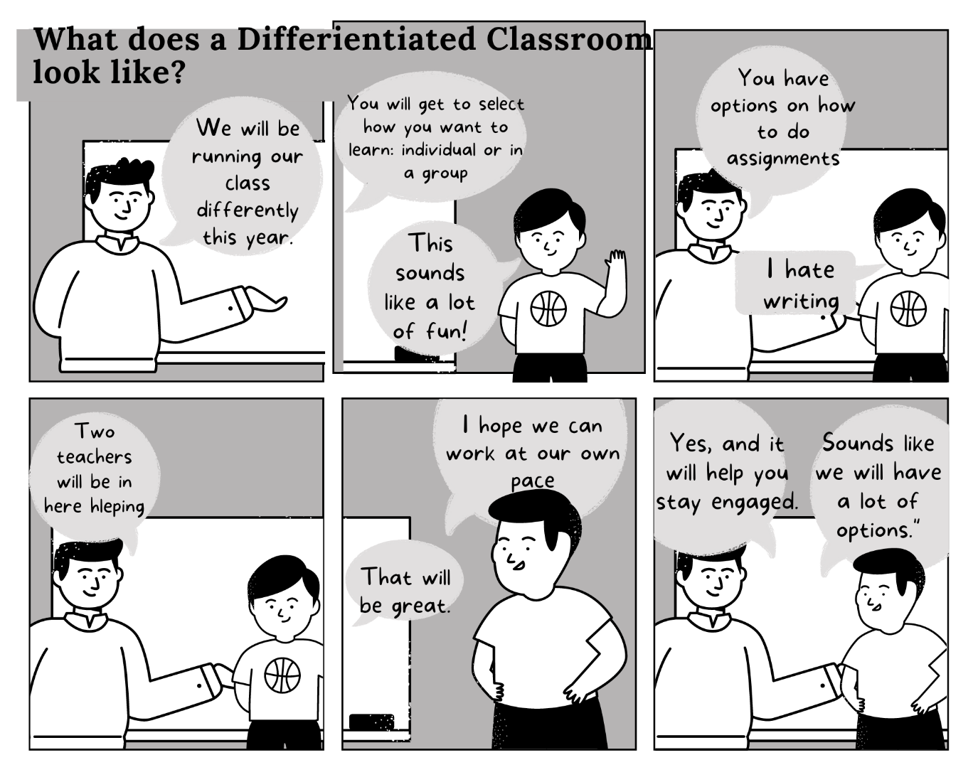
Differentiation and Choice
Product: RAFT
Task 3: Student to the Preservice Teacher
As a mentor teacher, you have asked students to create comics for the preservice teacher in your classroom about how your classroom differentiates to meet students needs. As your preservice teacher is new to your classroom, you want the novice teacher to feel welcome but also be aware of teaching expectations.
Write a comic strip using any tool of your choice highlighting the key elements of differentiation as if you were a student in the classroom welcoming a new student teacher.
(Doubet & Hocket, 2015, p.232; Doubet & Hocket, 2017, p. 285 )

Slide 14
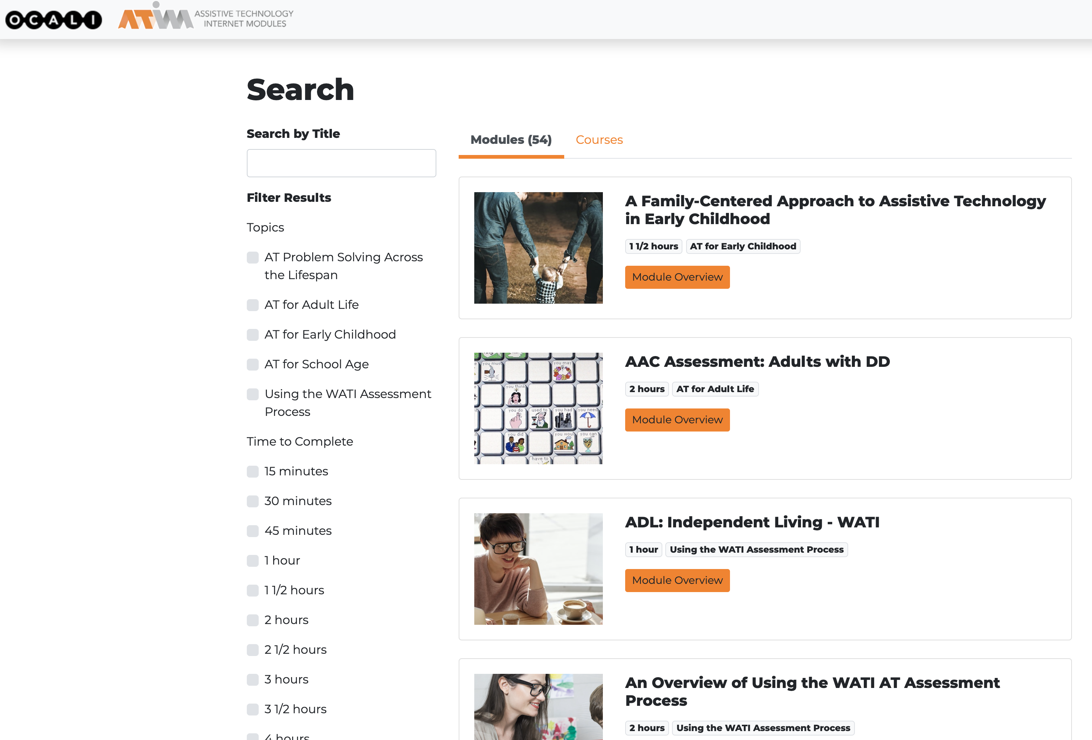



Differentiation and Choice
Content: Tic-Tac-Toe
A Family-Centered Approach to Assistive Technology in Early Childhood | Automatic Speech Recognition (ASR) / Speech-to-Text | AT Supports and Services in the IEP
AT Consideration in the IEP Process | Assistive and Smart Home Technology for Independent Living | AT Implementation
Navigating Accessible Instructional Materials | A Family-Centered Approach to Assistive Technology in Early Childhood | AT Assessment Process in the School Environment
https://atinternetmodules.org/
https://www.ocali.org/

Slide 15


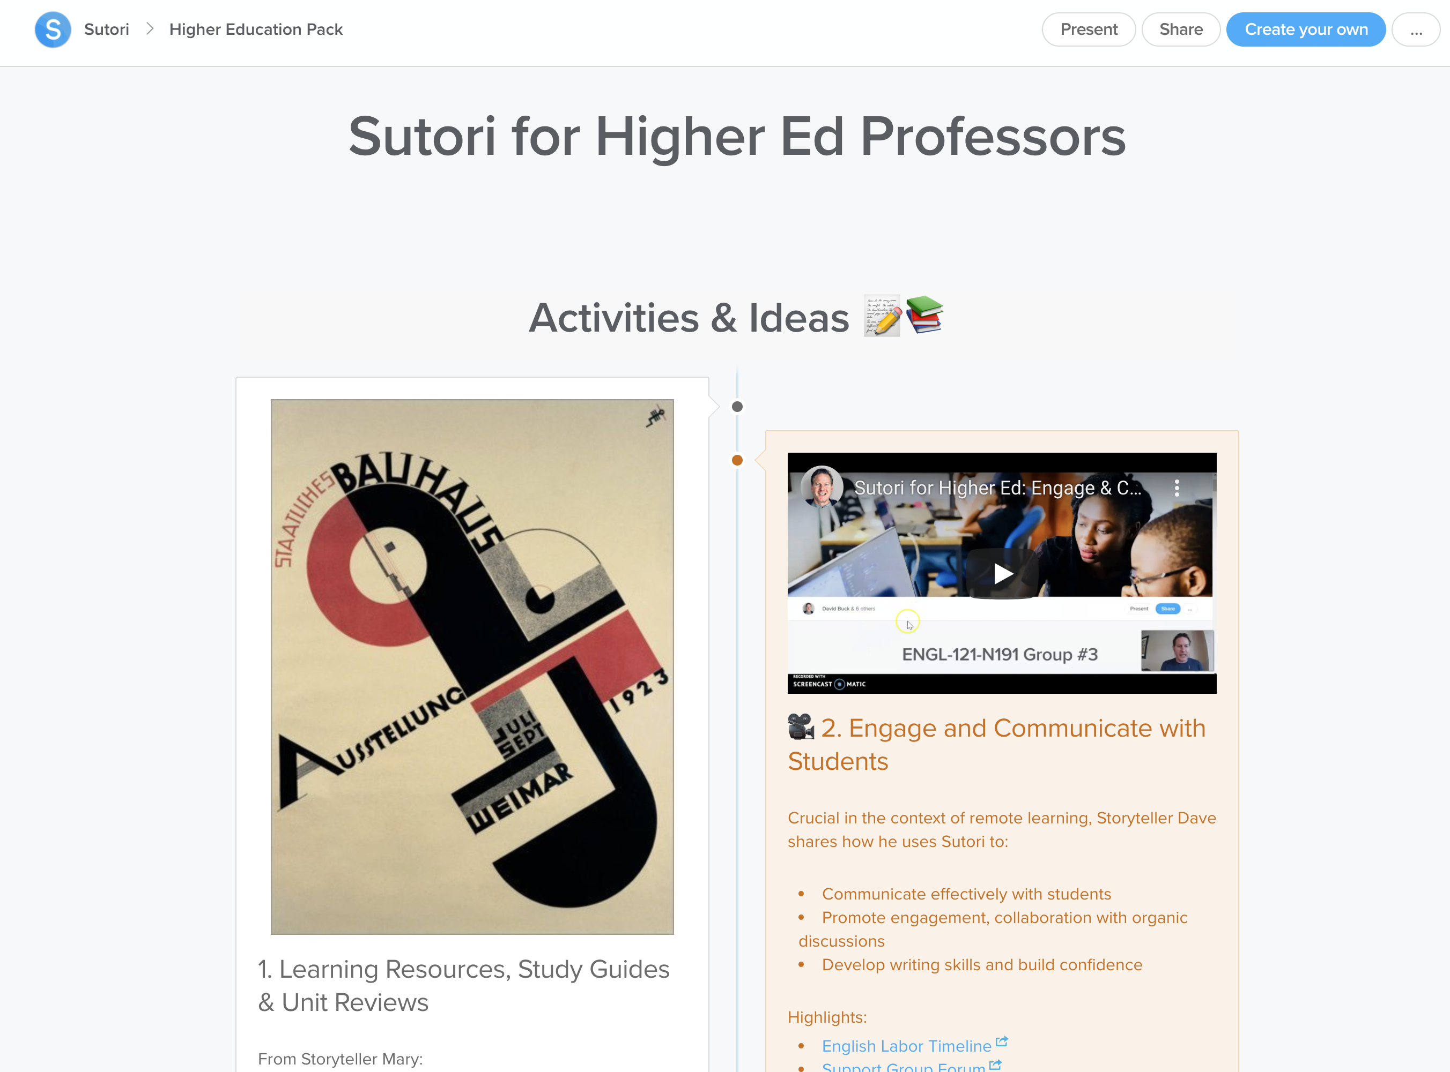



Differentiation and Choice
Process: 5, 3, 1 Sutori Model
Examine and identify 5 historical or research-based AT resources (museums, virtual field trips, national centers)
5
Read and summarize 3 articles related to historical and future implications of assistive technology.
3
Complete 1 collaborative
timeline project.
1
AT for Blind and Visually Impaired
https://www.sutori.com/story/history-of-at-for-the-blind-visually-impaired--CKgMkVSTfqsveeZM2hx8GCXp
AT for Deaf and Hard of Hearing
https://www.sutori.com/story/history-of-at-for-the-deaf-or-hard-of-hearing--LpA1wcTY5qNbNPoqsPd9NK2V
https://www.sutori.com/en/story/sutori-for-higher-ed-professors--yKgPsQYcQne19h3vW6QtEp3k

Slide 16

Stefanie L. McKoy
www.stefaniemckoy.com
slgordon@uark.edu
Krystle E. Merry
www.krystlemerry.com
kmerry@uark.edu

Slide 17
Resources
Doubet, K. J. & Hockett, J. A. (2015). Differentiation in middle and high school: Strategies to engage all learners. ASCD.
Doubet, K. J. & Hockett, J. A. (2017). Differentiation in the elementary grades: Strategies to engage and equip all learners. ASCD.
Mazzola, Colette. (2020). To what extent does education prepare students for the 21st century to become self-regulated,
future-proofed students, using networked, technological environments.. 10.13140/RG.2.2.18400.10246.
Sousa, D. A. & Tomlinson, C. A. (2018). Differentiation and the brain: How neuroscience supports the learner friendly classroom. Solution Tree.
Tomlinson, C.A. (2014). The differentiated classroom. ASCD.

