Slide 1


Integrating Interactive Participation: Developing a Gifted and Talented Teacher Preparation Program
Stefanie McKoy
University of Arkansas

Slide 2
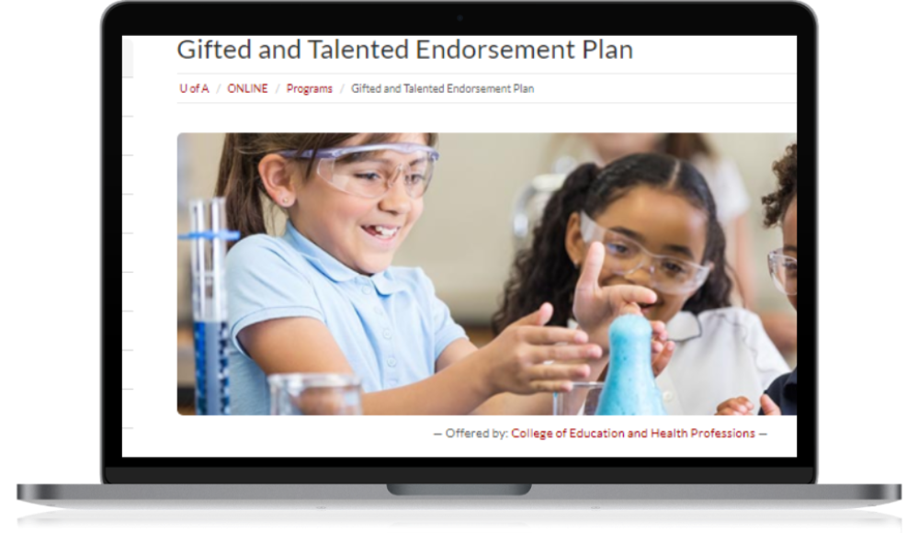
Today's Goals
  Provide an overview of the University of Arkansas's approach to a state-approved gifted and talented licensure endorsement program
  Discuss approaches to differentiate content including interactive modules
  Share the unique design team relationship behind the course program
https://online.uark.edu/programs/endorsement-plan-gifted-talented.php

Slide 3

Design Roles
Secondary Designer
& Subject matter
expert
Instructional
Designer Expert
  3 Team Members
    Instructional Designer
    Program Director / Subject Matter Expert
    Graduate Assistant / Secondary Designer & Subject Matter Expert
  Global Campus
  Quality Matters
Gifted and Talented
Subject Matter
Expert

Slide 4
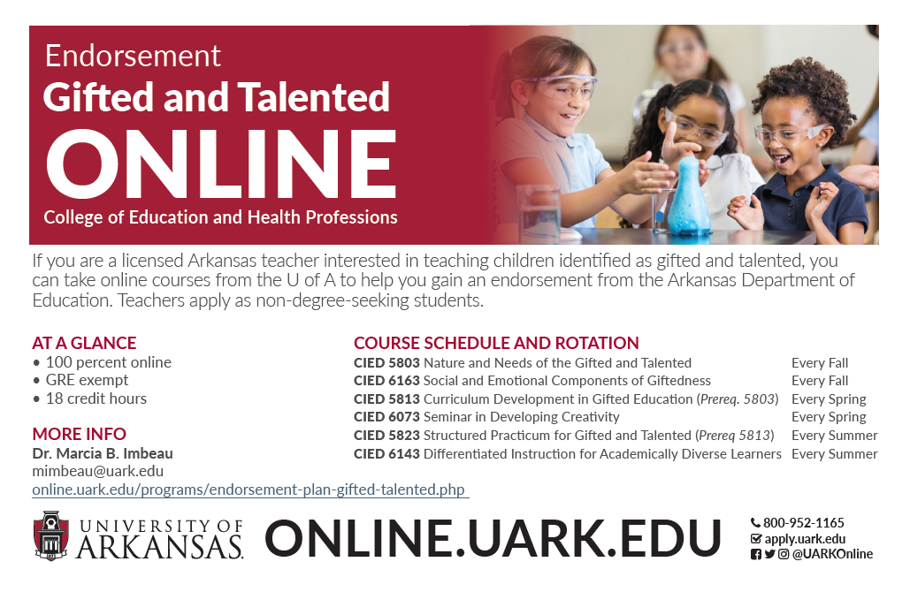

Slide 5
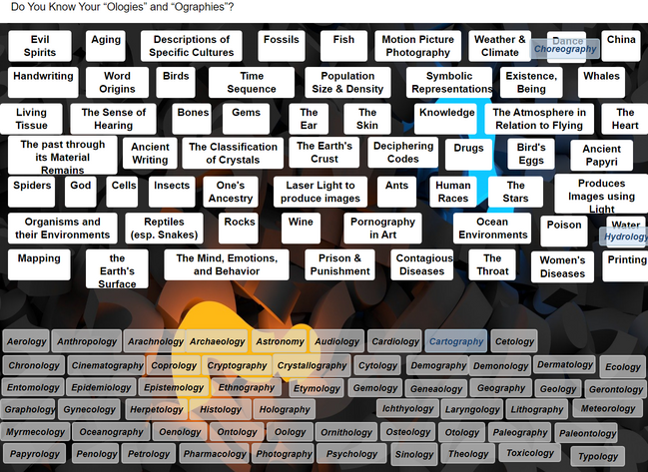
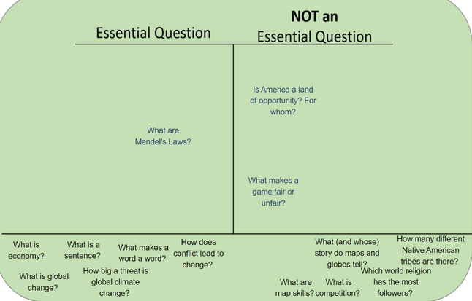
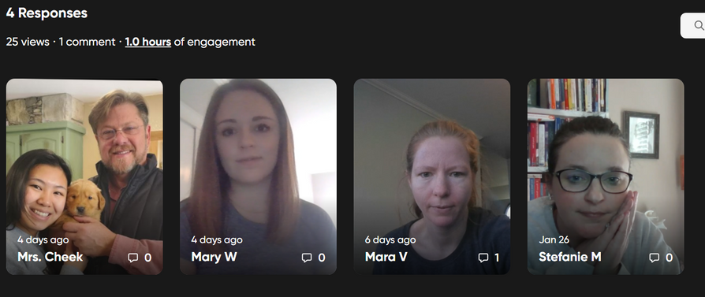
Interactive Content
  H5P
    Memory Games
    Flashcards
    Drag and Drop
    Branching Scenarios
    Image Hotspots
Collaborative Integration
  VoiceThread
    https://voicethread.com/
  Hypothesi.is
    https://web.hypothes.is/
  FlipGrid
    https://info.flipgrid.com/

Slide 6
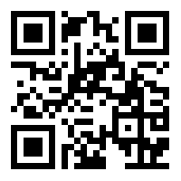
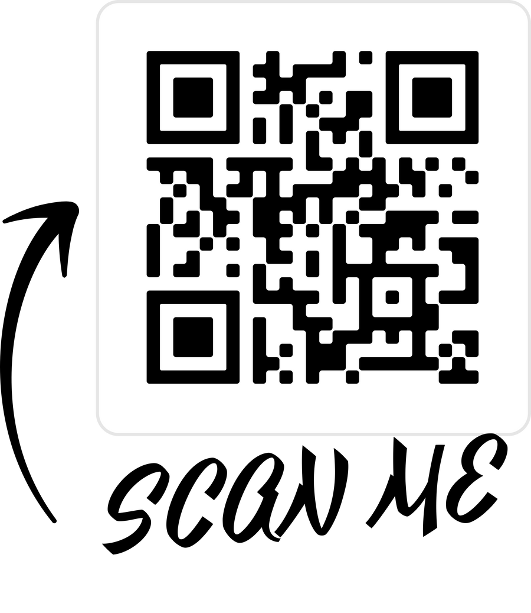
Nature and Needs of Gifted Students
An introductory course designed to provide participants with an overview of the field of education of the gifted and talented. Specifically, the course will review gifted and talented children's educational, psychological, and social characteristics.

Slide 7
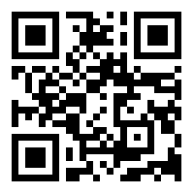
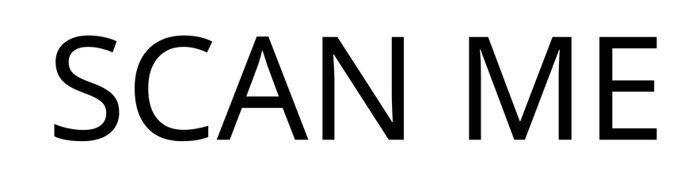
Social and Emotional Components of Gifted and Talented Students
This is an advanced course designed for the scholar-practitioner concerned with specific social and emotional issues in gifted education. The purpose of this course is to study the theoretical and practical aspects of those affective issues, behaviors, and experiences often associated with gifted and talented students.

Slide 8
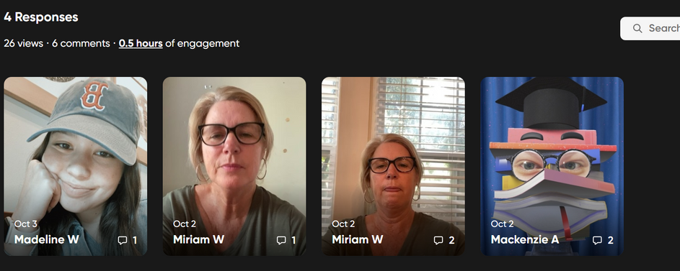
Ideal Bitmoji Classroom
Example 1
FALL COURSE EXAMPLES
Ideal Bitmoji Classroom
Example 2
Resiliency Newsletter
Trouble Newsletter
Parent Workshop
Special Population
Brochure

Slide 9
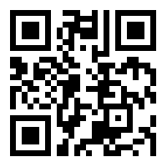

SEMINAR IN DEVELOPING CREATIVITY
The major purpose of this course is to introduce students to the major definitions, theories, and research related to the study of creativity and the creative individual. Additionally, students in this course will learn various techniques for developing creative thinking in their students, review tests and instruments for measuring creative thinking abilities, discuss methods for enhancing personal creative abilities, and evaluate techniques for examining the creative process.

Slide 10

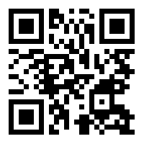
CURRICULUM DEVELOPMENT
IN GIFTED EDUCATION
The major purpose of this course is to study the theoretical and practical aspects of developing quality curricular experiences appropriate for advanced learners. The course has been designed to familiarize students with the Multiple Menu Model developed by Renzulli and the National Association for Gifted Children [NAGC]’s Parallel Curriculum Model in order to facilitate the development of a differentiated and defensible curriculum unit of study for use with gifted students.

Slide 11
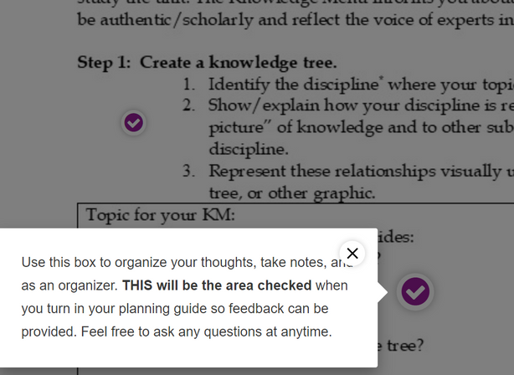
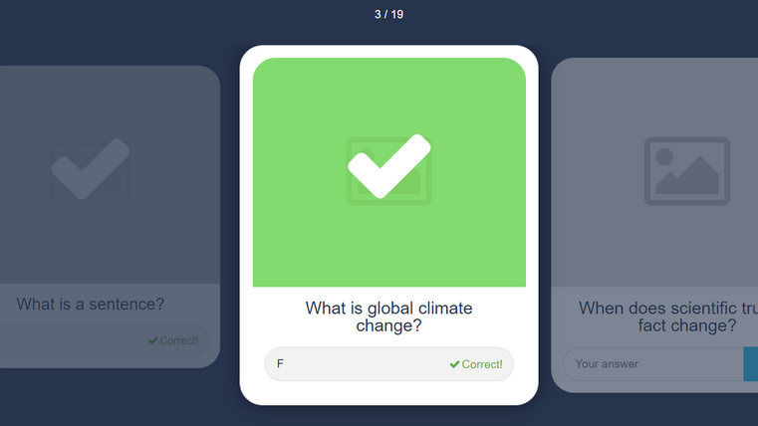
SPRING COURSE EXAMPLES
Theorists Outline
Invention Project
Creativity in the Classroom
Creative Person Interview
Speleology: Project Underground
Tree of Knowledge: Speleology

Slide 12
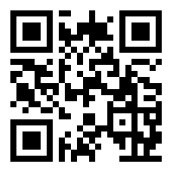
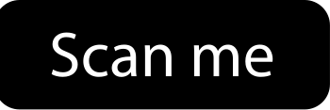
DIFFERENTIATED INSTRUCTION
FOR ACADEMICALLY DIVERSE LEARNERS
This course will explore many issues and strategies relevant to teaching advanced learners in the regular classroom. Several teaching practices appropriate for all grade levels that have been successful in challenging high-ability learners will be examined and serve as models for class members to design similar learning experiences they can use in their own classroom. A major focus of this course will be the study of differentiated instruction, a teaching philosophy appropriate for a wide range of learners. Additionally, analysis of the general curriculum will allow participants to determine ways that it can be modified and extended to better meet the educational needs of gifted learners and others.

Slide 13
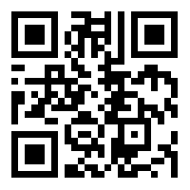

Advanced Gifted and Talented Practicum
This course is an advanced course designed for the scholar-practitioner concerned with applying what they have learned in previous gifted and talented education coursework and study to the real world of teachers/administrators in gifted programs. The major purpose of this course is to have students respond to a variety of situations/tasks that they will likely encounter in their work and develop a professional portfolio of various products that demonstrate specific competencies.

Slide 14
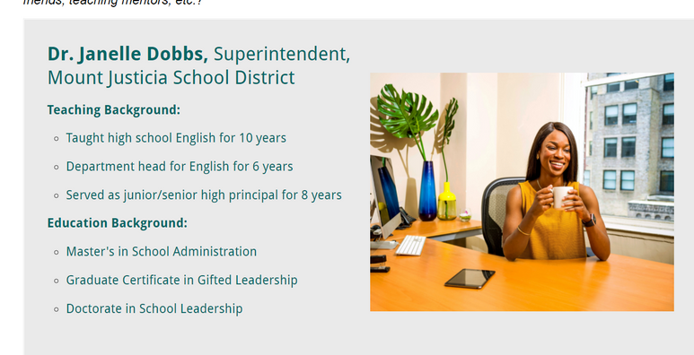
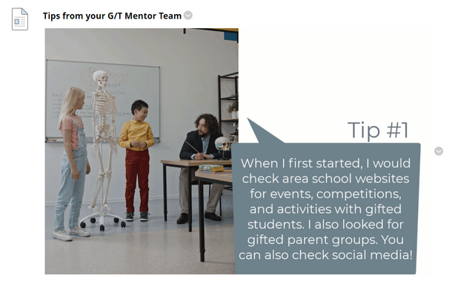
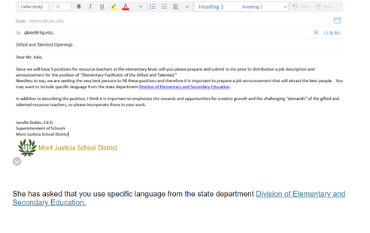
Differentiated Comic - Project
SUMMER COURSE EXAMPLES
Differentiated ABC Book - Project
Supporting a Gifted Field Trip
Buiding Gifted Community Ownership
District Curriculum Plan

Slide 15
Lessons Learned through Design
Listening to professionals in the field for years was an advantage but also consulting other colleagues was invaluable.
Using previous course evaluations and feedback provided insight into instructional gaps. Tips and additional resources were added to the platform to address those difficulties.
Working with designers who not only had great instructional design skills but who were also interested in the course content allowed the online classes to be much more engaging and interactive.
Differentiated projects through various media clearly demonstrated a students’ background knowledge, understanding, and skill.

Slide 16
Thank You
Stefanie McKoy
slgordon@uark.edu
www.stefaniemckoy.com
Twitter:@Stefanie_McKoy

